Slide 1

PROJECT WORK
COGNITIVE ROBOTICS
a.a. 2022/2023
Group 7
Tirino Francesca 0622701745
Mandragora Geraldino 0622701875
Sullutrone Giovanni 0622701751
Farina Luigi 0622701754
Prof.ssa Alessia Saggese

Slide 2
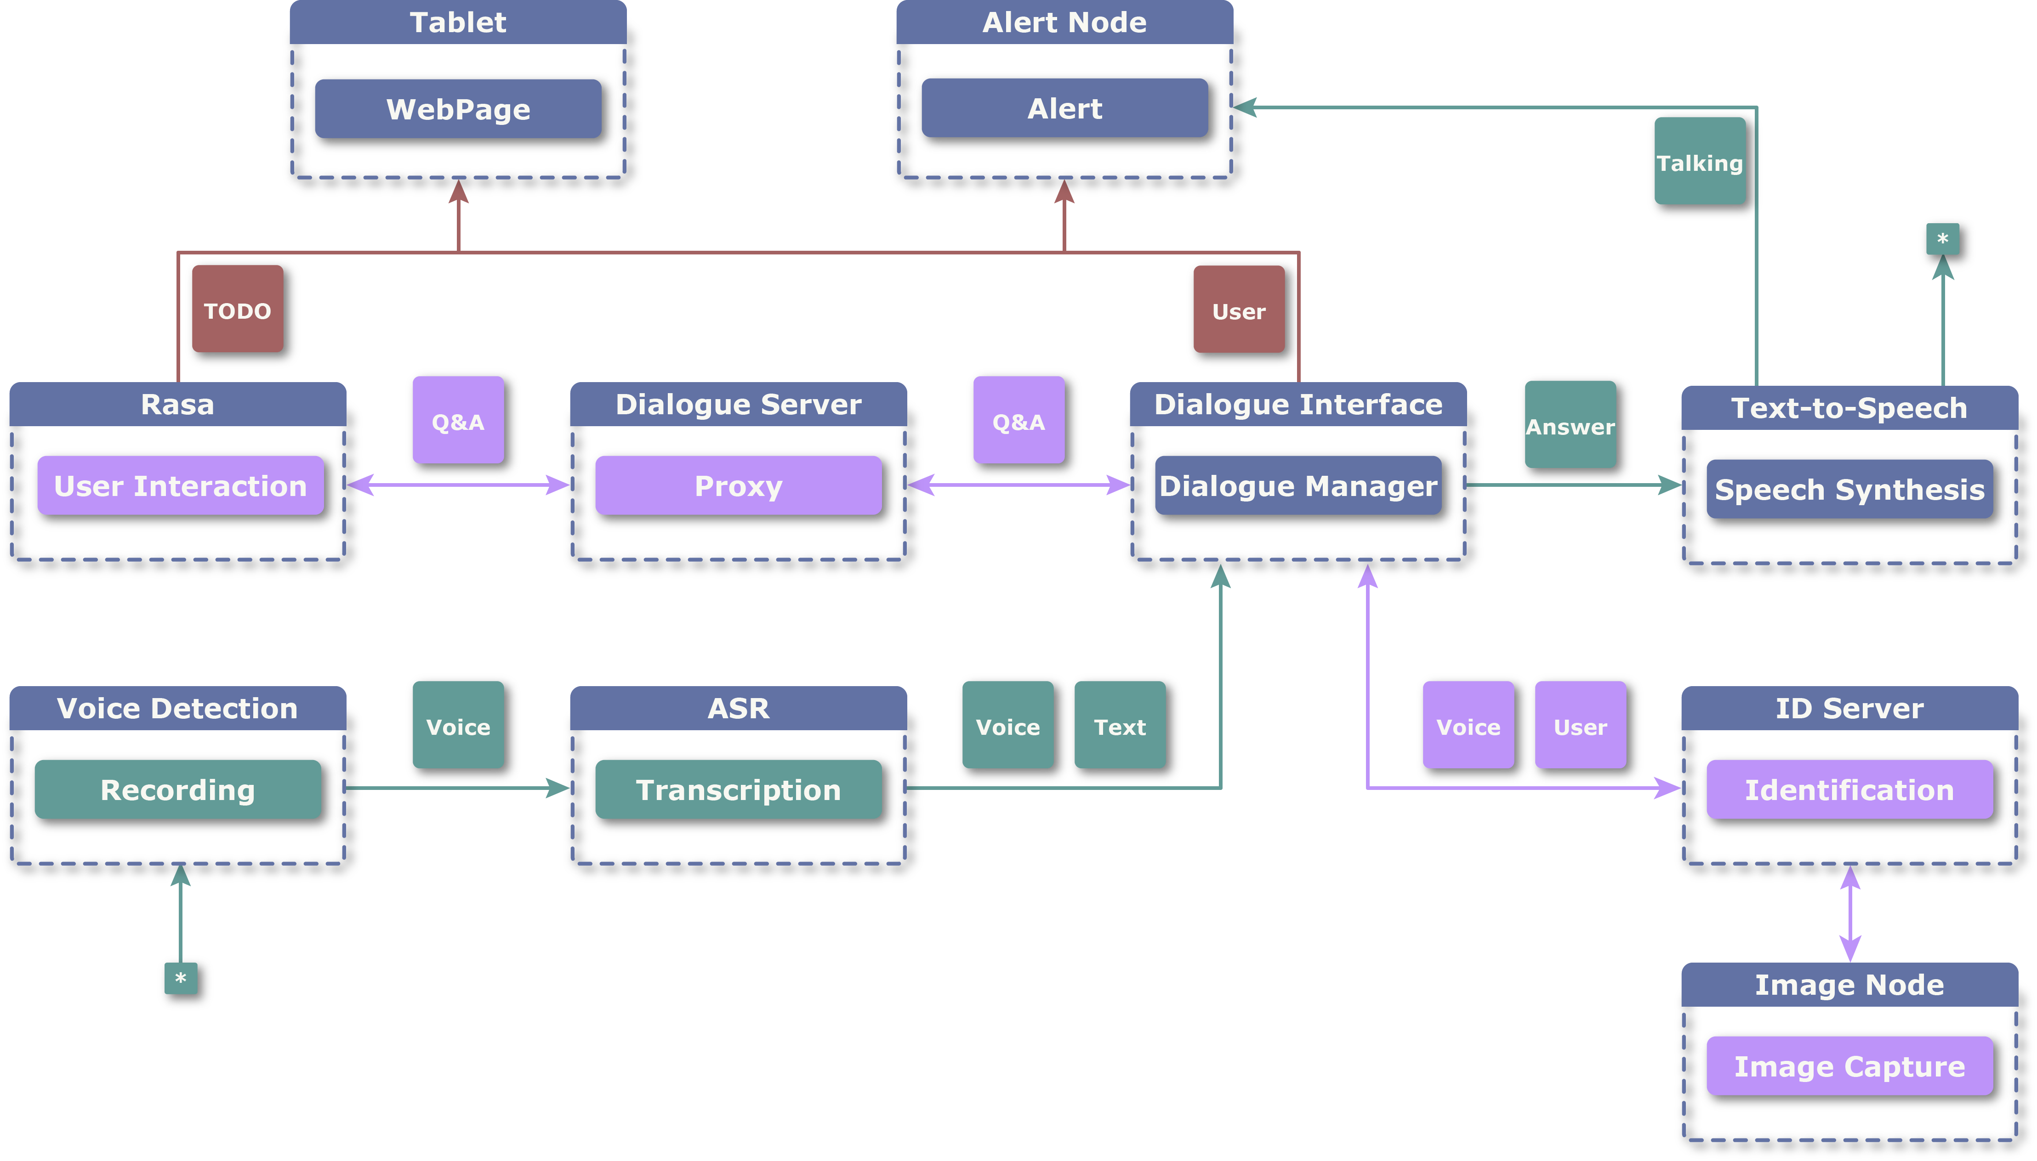
ROS ARCHITECTURE

Slide 3
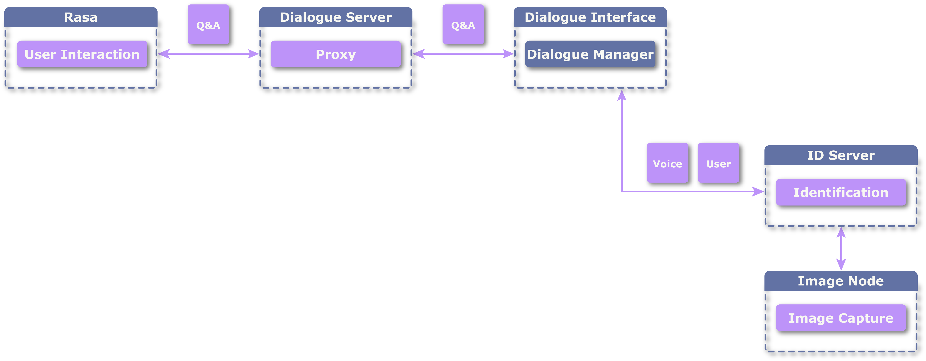
SERVICE

Slide 4
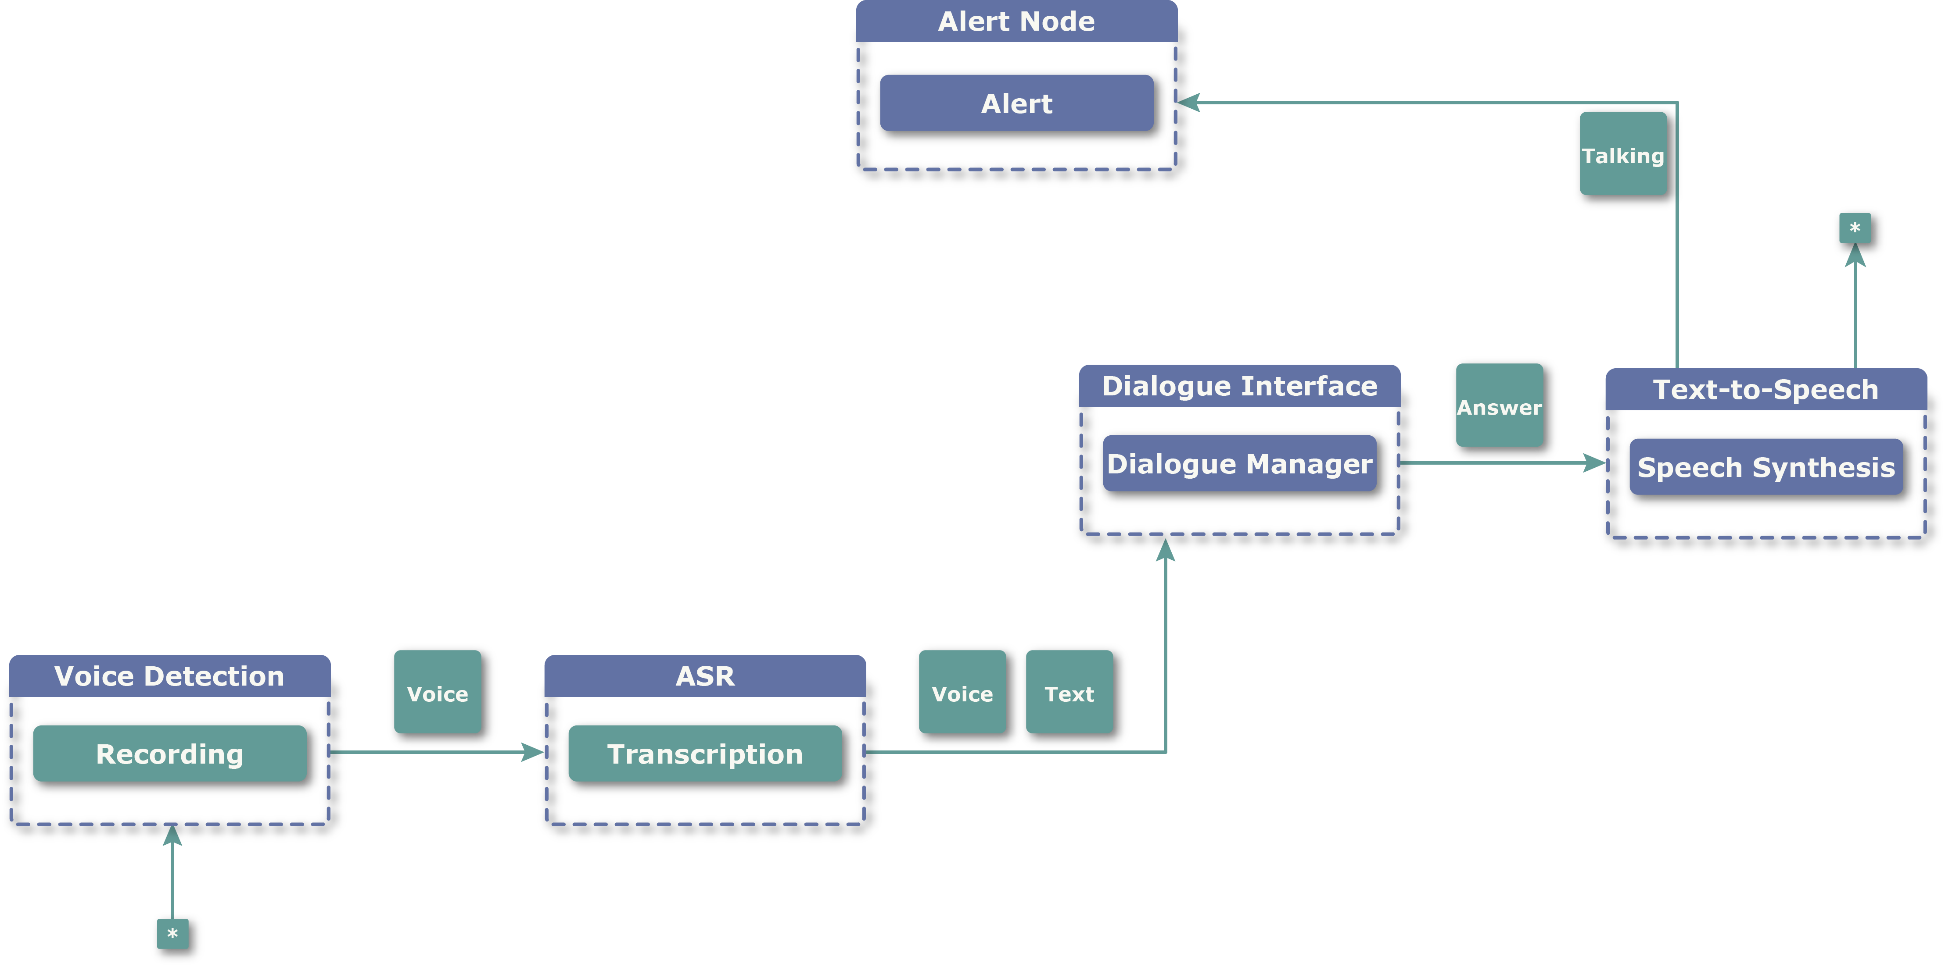
TOPIC PUBLISHER AND SUBSCRIBER

Slide 5
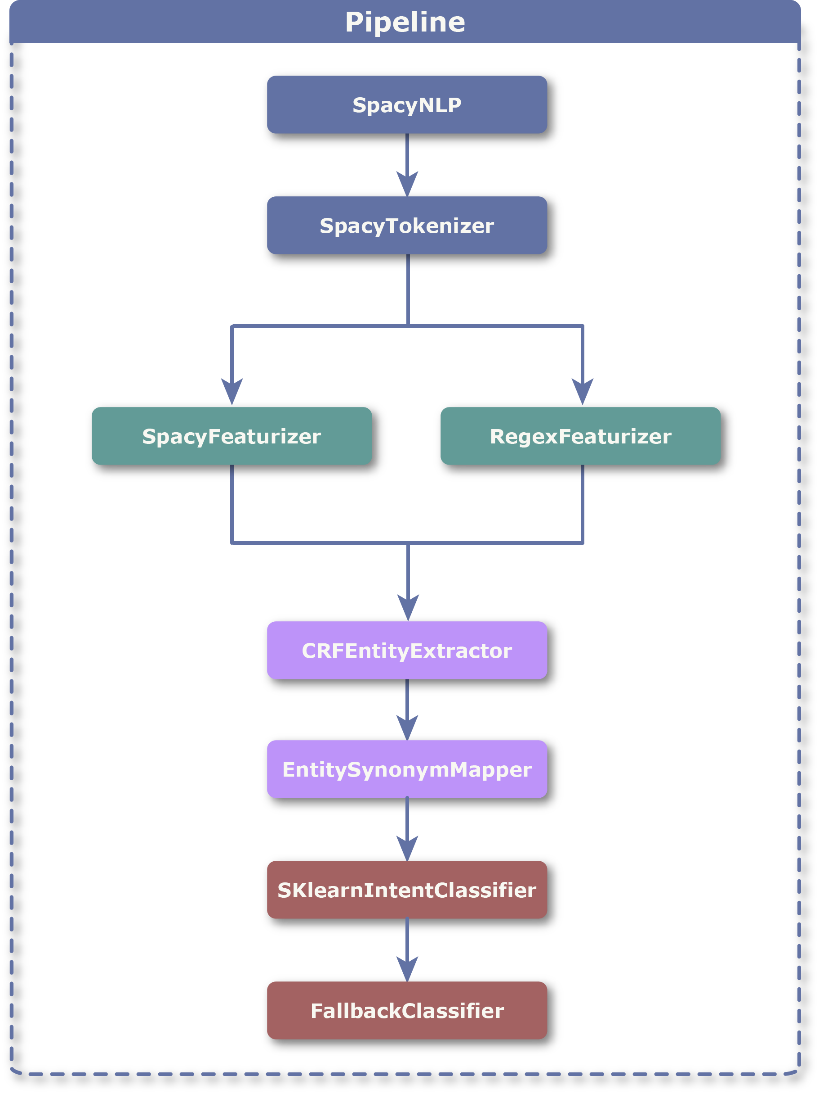
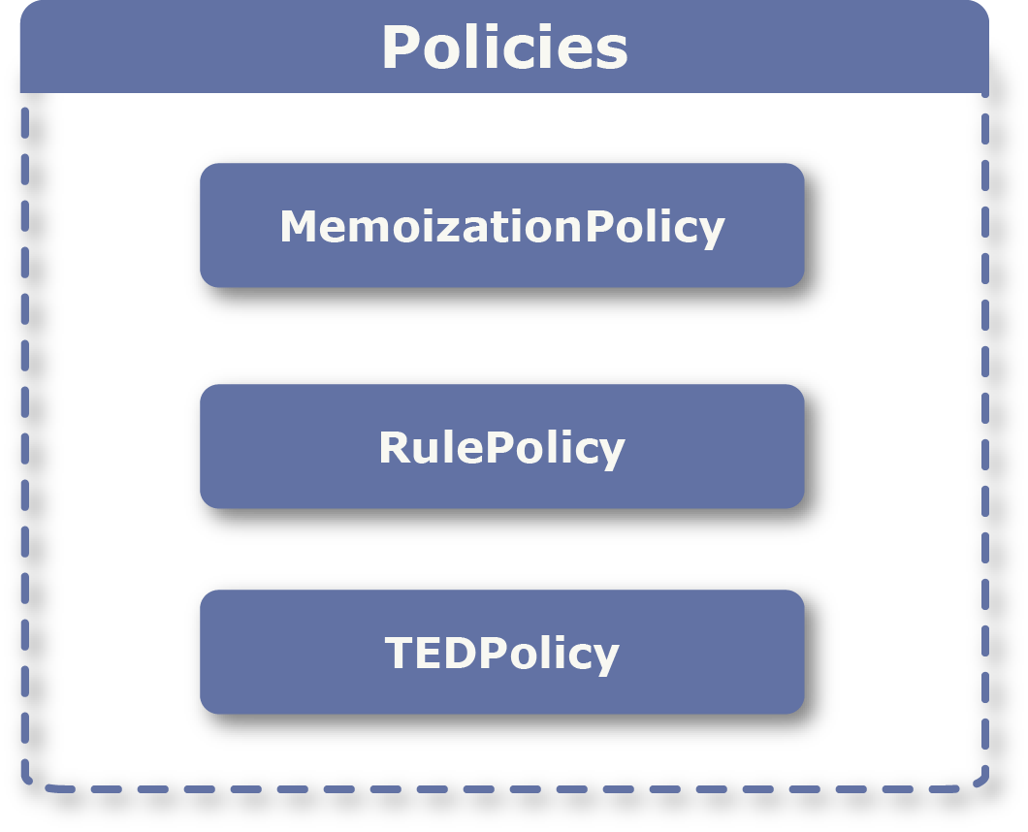
NLU AND DM MODULES

Slide 6
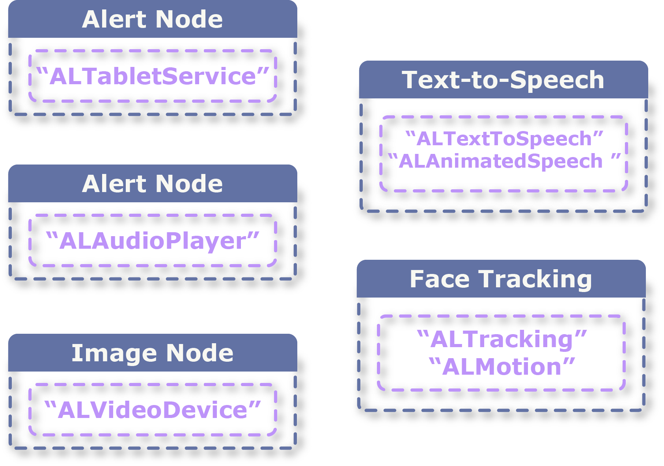
PEPPER NODES

Slide 7
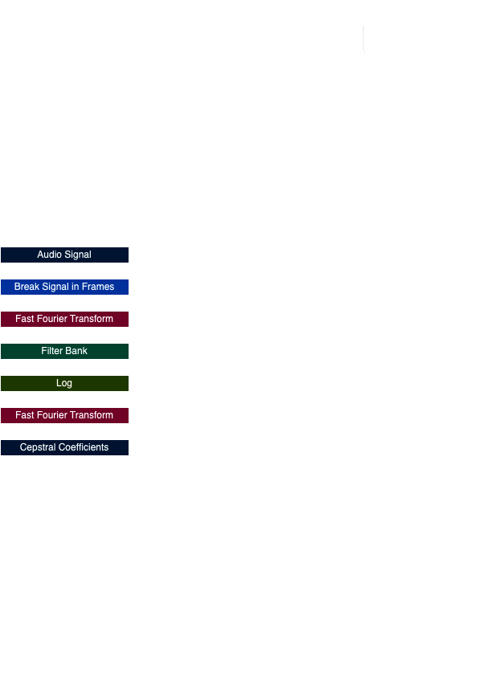
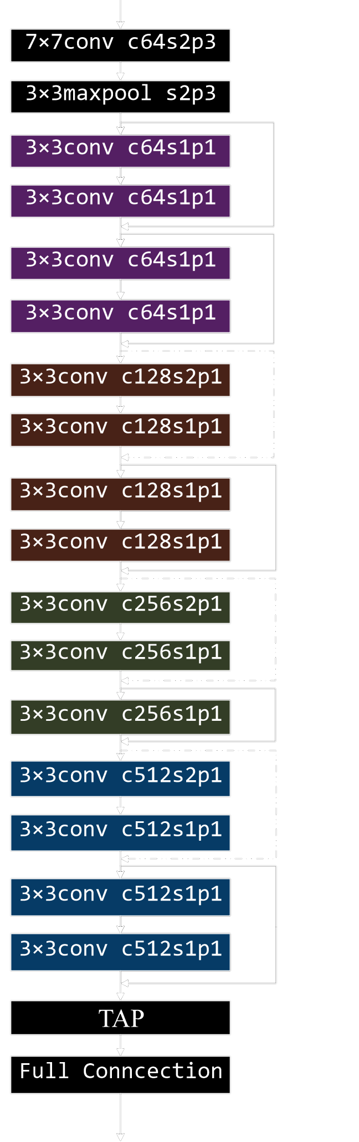
Speech Recognition
MFCC
ResNet18 + TAP + L2 normalization
Mean cosine distance to labels
Minimum distance (lower than treshold)
Full connection

Slide 8
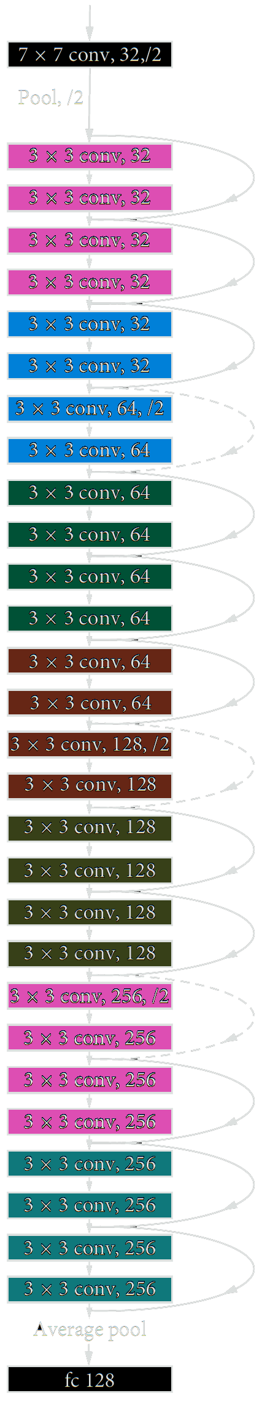
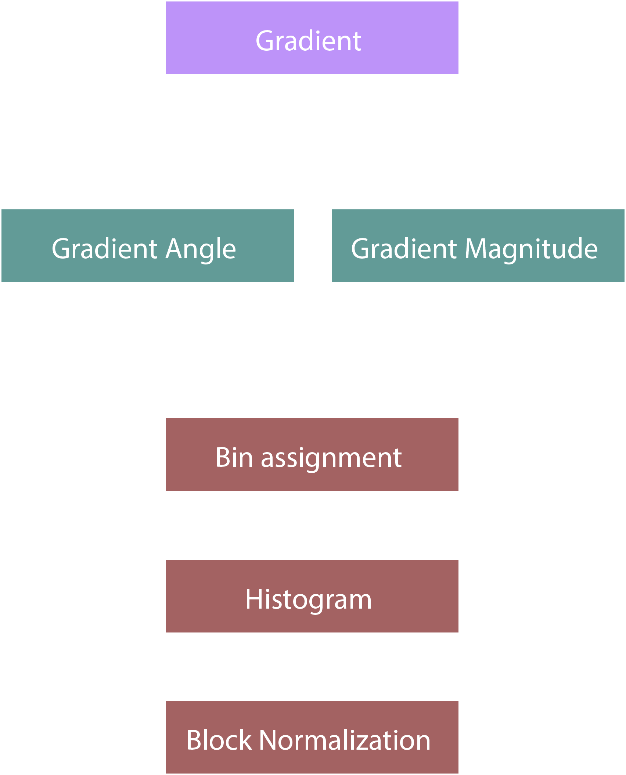
Face Analysis
HOG face detection
ResNet-29 face embeddings
Minimum distance (lower than treshold)

Slide 9
QUALITATIVE TEST
RASA
FACE
Rasa interactive
Rasa test with test_stories
Test without all slot filled
Difference between CRFEntityExtractor and SKLearnIntentClassifier and DIETClassifier
Camera: Pepper camera, camera laptop
With and without object
Various type of lightning
Varying distances
AUDIO
Microphone: Pepper array, directional, laptop
Normal situation, a lot of noise and rumble
Google Speech Recognition with different internet connection
Controlled environment and laboratory with people who spoke quietly

Slide 10
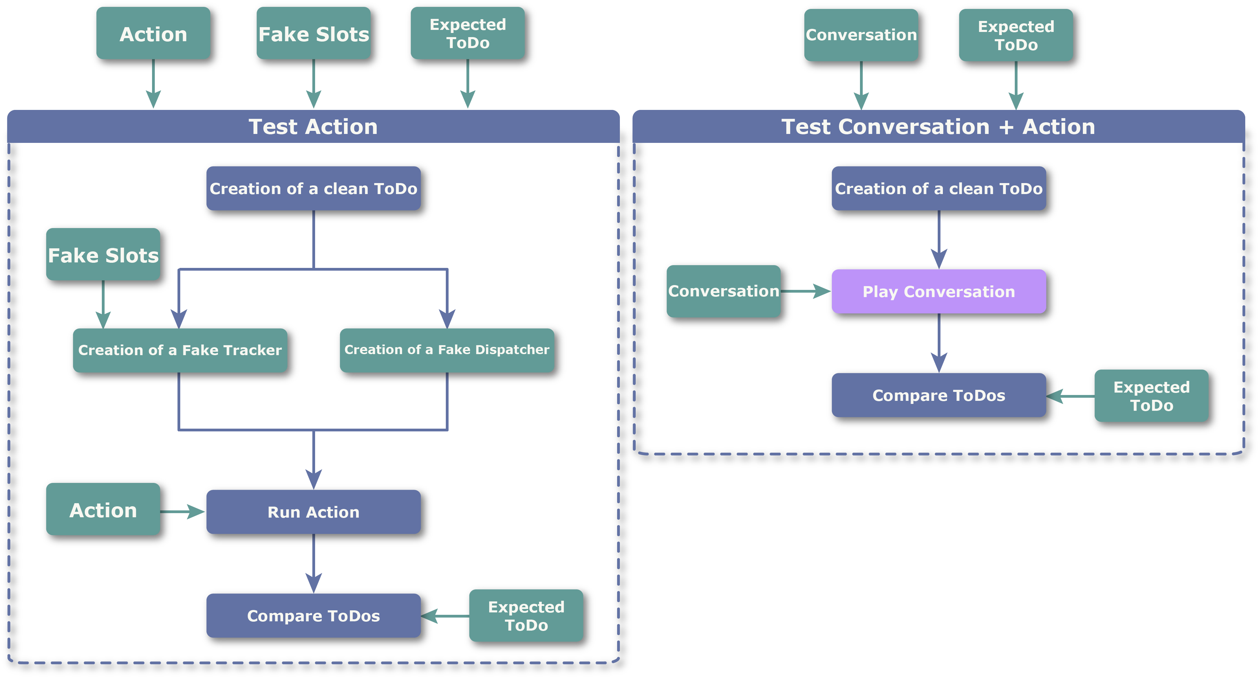
QUANTITATIVE TEST

